Slide 1

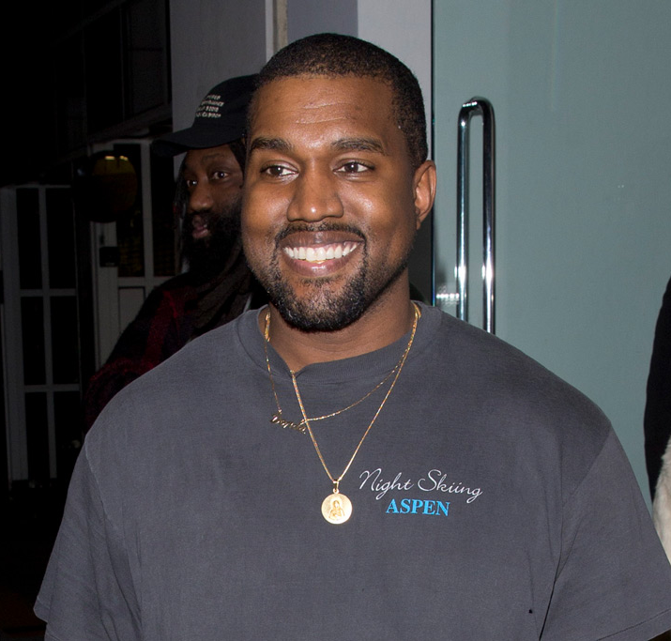
HUNGRY HUNGRY YE
A GAME BY MICHAL&SCOTT STUDIOS

Slide 2

ELEVATOR PITCH
A catch type game set in the glamorous city of Paris
Hungry Kanye collecting food falling from the top of the Eiffel Tower
Feast as much as possible, testing your reaction speed and awareness to the highest degree

Slide 3
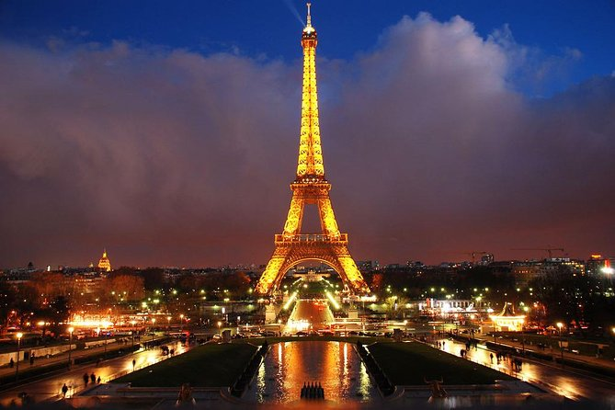
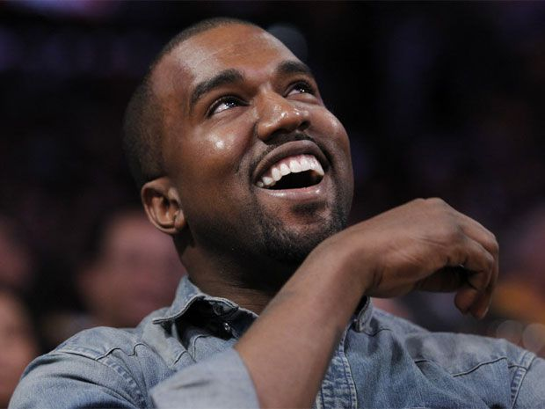
GAMEPLAY
DESCRIPTION
Collect all sorts of Kanye’s favourite foods – from Croissants to McDonald’s
Avoid other things dropping from the Eiffel Tower above.
Background music – medleys based off of Kanye’s discography

